Slide 1
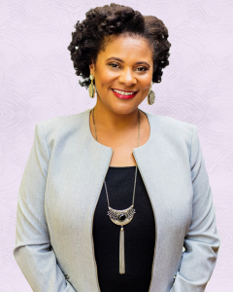
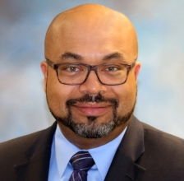
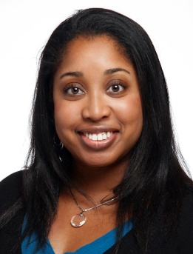
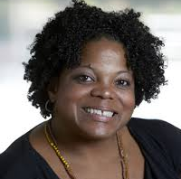
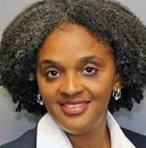
Join us for a discussion on The African American Experience in Multiple Myeloma May 13, 2021 3pm PST/6pm EST
Moderated by:
Register here: https://www.vaniamgroupevents.com/diversityinMM
Karen Winkfield, MD, PhD
Executive Director
Ingram Professor of Cancer Research at Vanderbilt Ingram Cancer Center
Craig Cole, MD
Assistant Professor
Michigan State University
Amy Pierre, RN, MSN, ANP-BC
Memorial Sloan Kettering Cancer Center
Clinical Director, Flatiron Health
Marya L Shegog, PhD, MPH, CHES
Lazarex Foundation, Health Equity and Diversity Coordinator
Tiffany Williams, DNP, APRN, CPNP-PC
Multiple Myeloma Patient and Advocate
Brought to you by
Notes:
No discussion of treatments – OK disease state and disparities

